Slide 1
Developing Custom Applications using Power BI Embedded

Slide 2
Agenda
Power BI Embedded Overview
Working with PBIX Project Files
Provisioning Workspaces in Azure
Embedding Reports in a MVC Application
Configuring Datasets for DirectQuery Mode
Putting It All Together

Slide 3
What is Power BI?
What is Power BI?
Cloud-based subscription service
Environment which promotes self-service BI to the end user
BI Platform to assists with data import, analysis and visualization
Power BI benefits from being a cloud-based service
It takes only 5 seconds to subscribe to the Power BI service
New users can create something significant in 5 minutes or less
Notes:
Power BI is a cloud-based subscription service from which provides business users with an environment participate in self-service BI. For ad-hoc scenarios is provides an end user with a straight-forward manner to import and analyze and to visualize insights from that data. To system integrators and data professionals, Power BI represents a platform for creating business solutions that assists with data analysis and insight visualization.
Because Power BI benefits is a cloud-based service, a new user can subscribe in under a minute. Another important goal of the Power BI team at Microsoft was to remove dependencies so that new users can quickly begin importing data and creating visuals using nothing more than the browser.
As of March 2016, the Power BI service has experience strong adoption numbers. The Power BI service has surpassed 5 million subscribers who come from over 200,000 different organizations. The Power BI service subscribers come from many different countries and take advantage of the fact that the Power BI service has been localized for over 40 different languages.

Slide 4
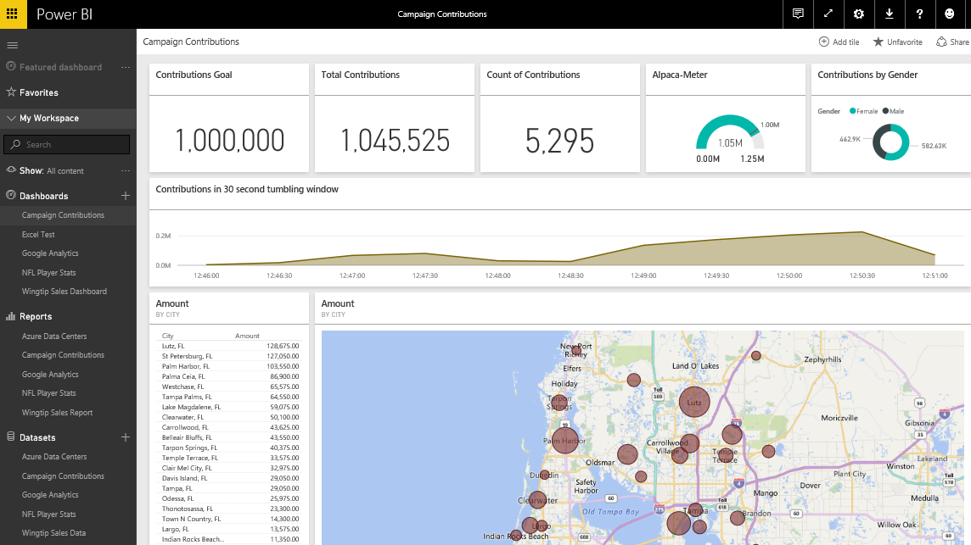
The Power BI Service at PowerBI.com
The Power BI service is accessible through browser
Provides cloud-based foundation for Power BI platform
Accessible through URL at https://app.powerbi.com
Users require Office 365 accounts and Power BI Licenses

Slide 5
What is Power BI Embedded?
Power BI Embedded is an Azure Service
PBI Embedded service can be provisioned on-demand
Service provisioned in terms of workspace collections
PBI Embedded service requires an Azure subscription
What is the core value of Power BI Embedded?
It eliminates need for Power BI license for each user
It eliminates need for Office 365 account for each user
It decouples user security from app security
It opens up PBI platform to commercial applications

Slide 6
PowerBI.com versus Power BI Embedded
PowerBI.com
-----------------------
Accessed via https://app.powerbi.com
Requires Office 365 accounts
Requires Power BI License
Custom development not required
Azure subscription not required
Power BI Embedded
-----------------------
Accessed via custom URL
No Office 365 accounts required
No Power BI user licenses required
Requires custom development
Requires Azure subscription

Slide 7
The Big Picture for Power BI Embedded
Create > Design > Test a PBIX project file on local PC
Done using Power BI Desktop
Note that Power BI Desktop only runs on Windows
Provision Azure resources for Power BI Embedded
Create a Power BI workspace collection
Create Power BI workspaces
Upload PBIX file to Power BI Embedded workspace
Use PowerShell, Power BI CLI or Azure REST API
Develop Web App with Embedded Power BI Reports
Most easily accomplished using ASP.NET MVC

Slide 8
Agenda
Power BI Embedded Overview
Working with PBIX Project Files
Provisioning Workspaces in Azure
Embedding Reports in a MVC Application
Configuring Datasets for DirectQuery Mode
Putting It All Together

Slide 9
Working with Power BI Desktop
Power BI Desktop used to design PBIX projects
Data Source and Query features for Data Discovery
Query features for ETL (extract-transform-load)
Data modeling features and DAX language
Report design features with a visual report designer
Tasks performed using Power BI Desktop
Data Discovery
ELT
Data Modeling
Design Reports

Slide 10
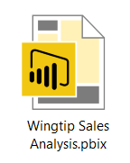
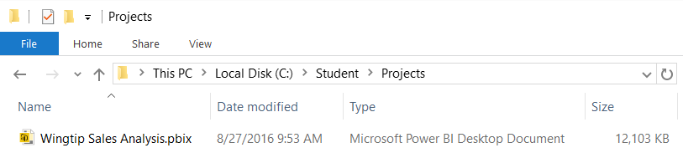
Projects and PBIX Files
Power BI Desktop projects saved using PBIX files
PBIX file contains data source definitions
PBIX file contains query definitions
PBIX file contains data imported from queries
PBIX file contains exactly one data model definition
PBIX file contains exactly one report
PBIX file never contains data source credentials

Slide 11
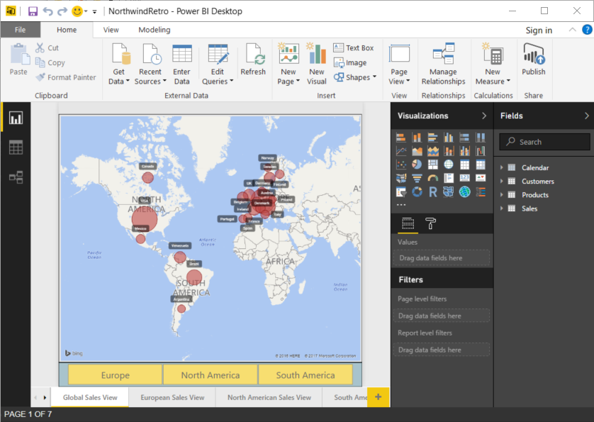
Demo: NorthwindRetro.pbix

Slide 12
Agenda
Power BI Embedded Overview
Working with PBIX Project Files
Provisioning Workspaces in Azure
Embedding Reports in a MVC Application
Configuring Datasets for DirectQuery Mode
Putting It All Together

Slide 13
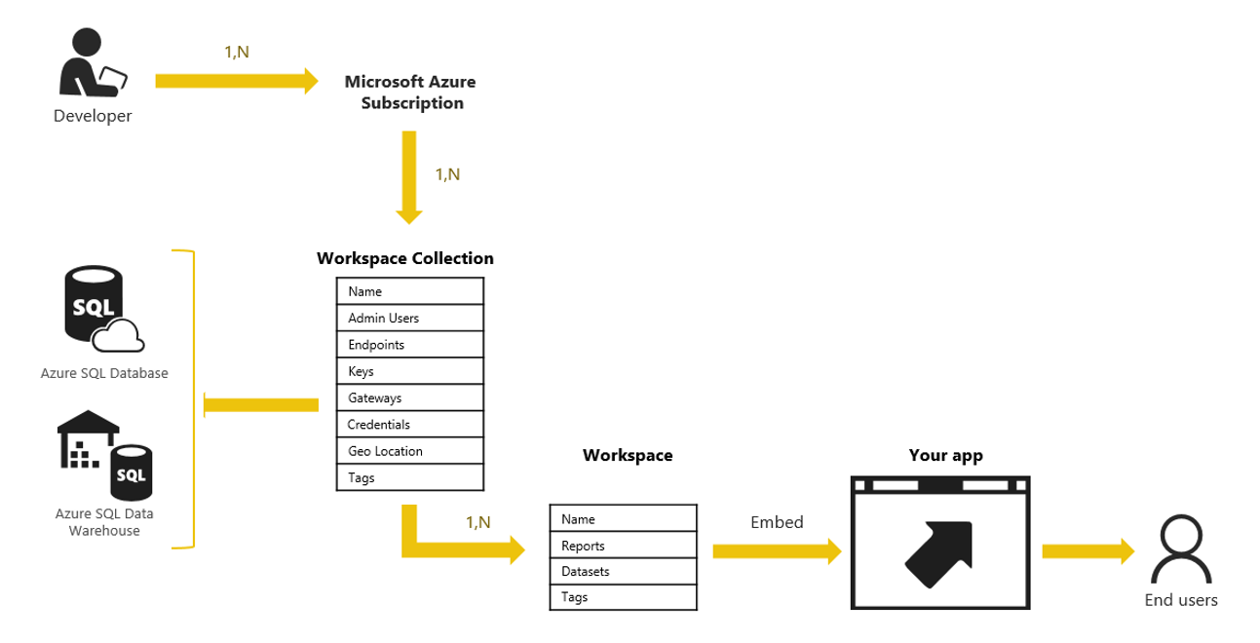
Power BI Embedded Service in Azure
Creating a Power BI workspace collection
Can be done by hand in Azure portal
Can be done with PowerShell and PowerBI-CLI utility
Can be done using C# and Azure ARM APIs
Workspace collection contains access keys

Slide 14
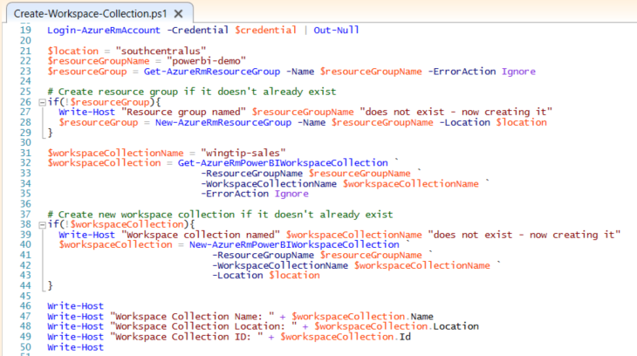
Create-Workspace-Collection.ps1

Slide 15
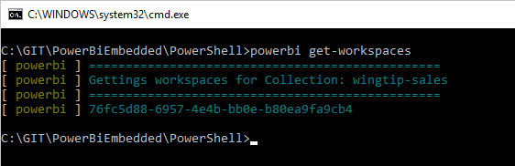
PowerBI-CLI
PowerBI-CLI is command-line utility for Power BI
Maintained at https://github.com/Microsoft/PowerBI-Cli
Installed using Node Package Manager
npm install powerbi-cli -g
Supported on Windows, Mac and Linux
Can be accessed using any command prompt
Can be automated using PowerShell script

Slide 16
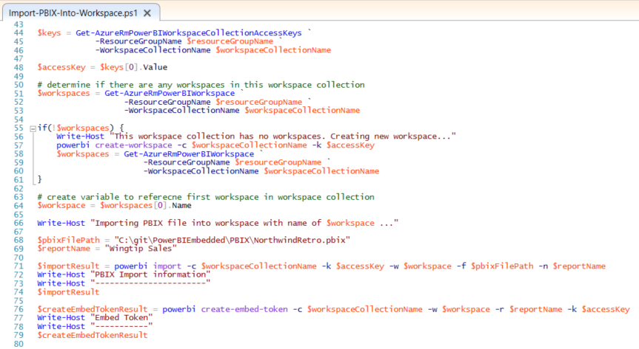
Import-PBIX-Into-Workspace.ps1

Slide 17
Agenda
Power BI Embedded Overview
Working with PBIX Project Files
Provisioning Workspaces in Azure
Embedding Reports in a MVC Application
Configuring Datasets for DirectQuery Mode
Putting It All Together

Slide 18
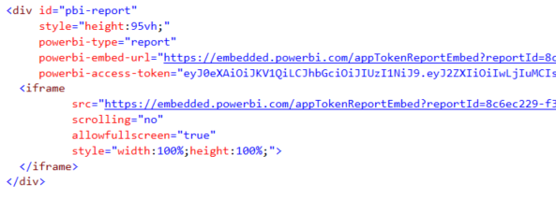
Embedding Internals
How are Power BI Reports Embedded?
It’s done using an iFrame
iFrame requires event to load embed token

Slide 19
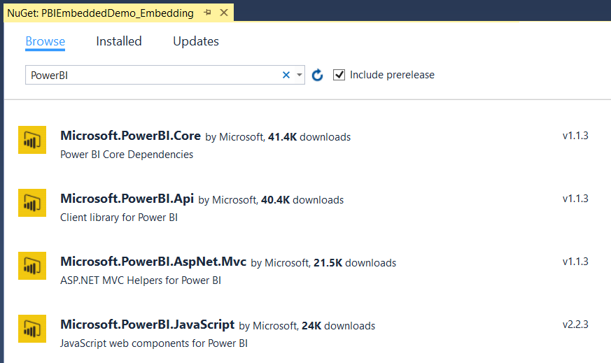
Creating an ASP.NET MVC Application
Add the following Nuget Packages

Slide 20
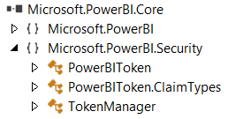

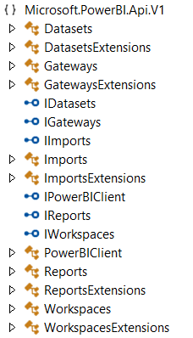
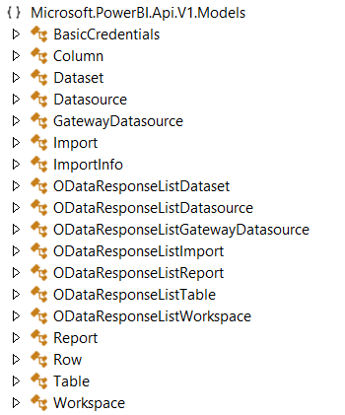
Power BI .NET APIs

Slide 21



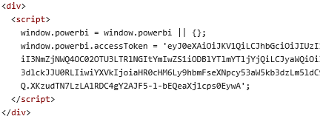

MVC Helper Classes

Slide 22
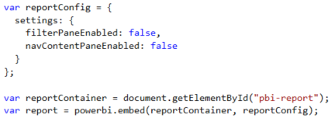
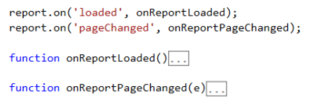
Power BI JavaScript API
Used to generate iFrame required for embedding
Call to powerbi.embed creates iFrame for embedding
API supports binding to report-level events

Slide 23
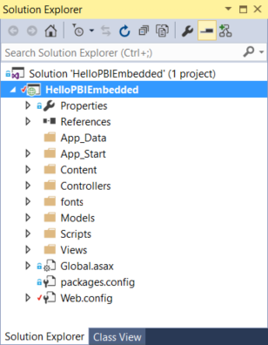
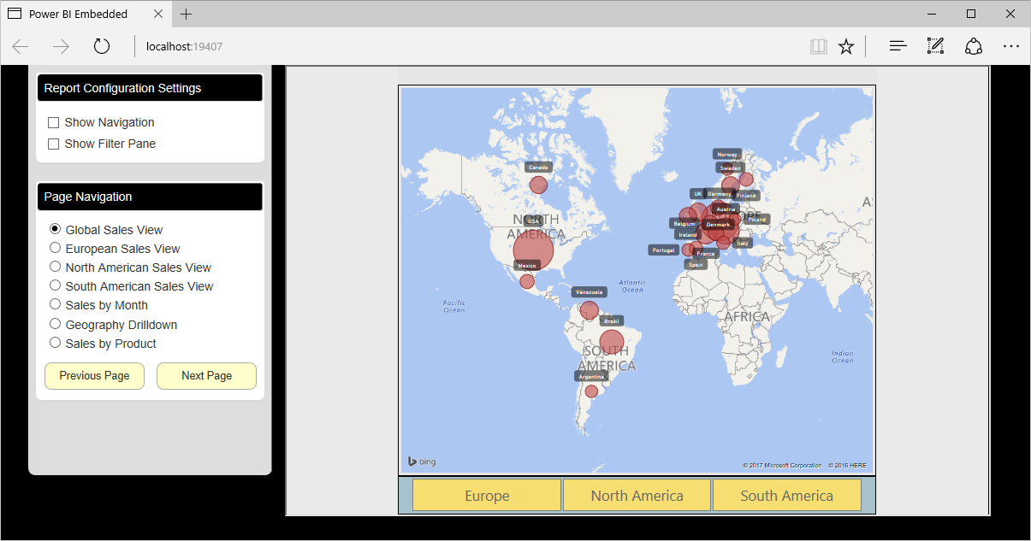
Demo: HelloPowerBIEmbedded.sln

Slide 24
Agenda
Power BI Embedded Overview
Working with PBIX Project Files
Provisioning Workspaces in Azure
Embedding Reports in a MVC Application
Configuring Datasets for DirectQuery Mode
Putting It All Together

Slide 25
Imported Datasets Versus DirectQuery
Imported Dataset
Data is imported into storage within Power BI cloud
Entire dataset loaded into memory when in use
Reports and Datasets query data in imported dataset
Dataset size is maxed out at 1GB
Dataset must be refreshed when source data changes
DirectQuery Dataset
No data is imported or cached in the Power BI cloud
Reports and Datasets query for data using live connection
No need to refresh data
No need to worry about 1GB dataset size limitation
Limitation are placed on features for querying and data modeling

Slide 26
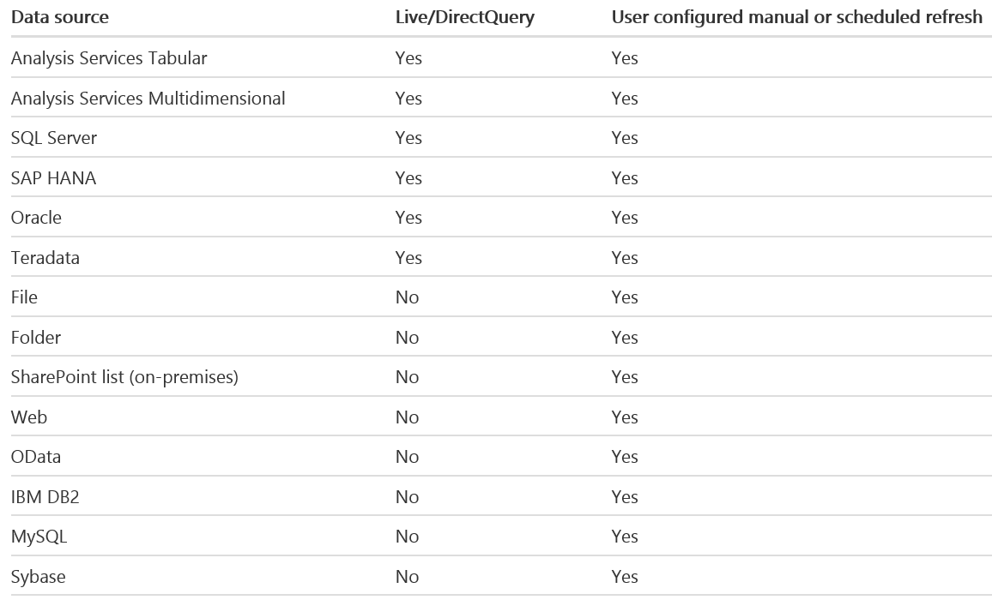
Supported Data Sources

Slide 27
Limitations of DirectQuery
DirectQuery imposes the following limitations
All tables must come from a single database
Many types of query steps are not supported
Relationship filtering limited to single direction
Time intelligence capabilities are not available
No special treatment of date columns
Calculated columns not allowed
By default, limitations placed on DAX in measures

Slide 28
Demo: WingtipSalesDirectQuery.pbix
Power BI Embedded does not support dataset refresh
Now way to refresh imported dataset – different than PowerBI.com
Requires delete and reimporting updated PBIX project
DirectQuery mode can be used to eliminate the refresh problem

Slide 29
Provisioning with C# and Azure REST APIs
Can be programmed in simple Console app
Use same Nuget packages as shown earlier
Dataset management is important
Credentials cannot be included in PBIX
Credentials must be configured after PBIX import
Terminology confusion
Remember that “Import” = “Dataset” = “Report”

Slide 30
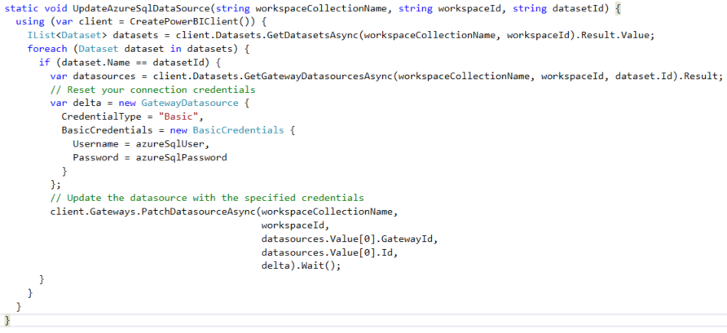
Configuring a Dataset for DirectConnect

Slide 31
Agenda
Power BI Embedded Overview
Working with PBIX Project Files
Provisioning Workspaces in Azure
Embedding Reports in a MVC Application
Configuring Datasets for DirectQuery Mode
Putting It All Together

Slide 32
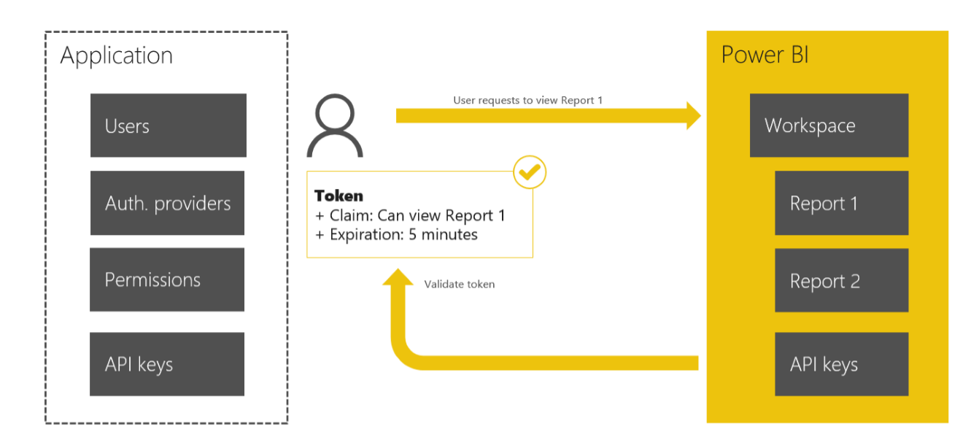
Security with Power BI Embedded
Power BI Embedded defers to your app…
to perform all the necessary user authentication
to provide an authorization scheme
PBI Embedded supports row-level security (RLS)

Slide 33

Critical Path Training
PBD365: Power BI Developer Boot Camp – 4 Days
Audience is Professional Developers
Teaches developing custom visuals with TypeScript and D3
Teaches R programming and integrating R with Power BI
Teaches programming with the Power BI REST API
Teaches developing with Power BI Embedded
PBI365: Power BI Boot Camp – 3 Days
Audience is Business Users, Analysts and Data Professionals
Provides hands-on introduction to the Power BI platform
Focuses on build solutions using Power BI Desktop
Query design, data modeling and report and dashboard design
Group Workspaces and Organizational Content Packs
Learn about “import” vs “connect to” with Excel workbooks

Slide 34
Summary
Power BI Embedded Overview
Working with PBIX Project Files
Provisioning Workspaces in Azure
Embedding Reports in a MVC Application
Configuring Datasets for DirectQuery Mode
Putting It All Together

